Slide 1
Build Your own dv automation on azure synapse
Noel Cruz

Slide 2
AGENDA
Introduction: Why Build Your Own?
Gathering the Basic Automation Tools
Building the Automation Templates
Creating the Automation Structures
Developing the Automation Pipelines
Resources

Slide 3
Introduction: why build your own?
A short story from a developer who has done it…twice!

Slide 4
Gathering the basic automation tools

Slide 5
What is azure synapse?
“Azure Synapse is an enterprise analytics service that accelerates time to insight across data warehouses and big data systems. Azure Synapse brings together the best of SQL technologies used in enterprise data warehousing, Spark technologies used for big data, Data Explorer for log and time series analytics, Pipelines for data integration and ETL/ELT, and deep integration with other Azure services such as Power BI, CosmosDB, and AzureML.”
SOURCE: https://docs.microsoft.com/en-us/azure/synapse-analytics/overview-what-is

Slide 6
Defining synapse
syn​•apse | \sə-ˈnaps\
: the point at which a nervous impulse passes from one neuron to another
Etymology: New Latin synapsis, from Greek, juncture, from synaptein to fasten together, from syn- + haptein to fasten
SOURCE: https://www.merriam-webster.com/dictionary/synapse

Slide 7
Gathering tools
While Azure offers a variety of viable options, I chose to use Azure Data Lake Storage Gen2 (ADLS Gen2). Performance, scalability and security helped make this an easy choice…that and Azure defaults to this when setting up an account.
Land the Data
Store the Data
Azure’s SQL Dedicated Pool sits at the heart of Azure Synapse. It uses columnar storage for relational data, which can be manipulated and accessed with T-SQL.
Azure Synapse provides an array of tools to transform the data according to Data Vault standards. Views, stored procedures and SQL functions (including user defined) form the bulk of this automation.
Conform the Data
Move the Data
Pipelines and Triggers together form the engine that moves the data from source to target.

Slide 8
building the automation templates

Slide 9
Generating hubs
Pseudo-Code
Stored Procedure Template
SELECT
HashKey,
BusinessKey,
LoadDateTimeStamp,
RecordSource
FROM Stage STG
WHERE STG.HashKey NOT IN (
SELECT h.HashKey
FROM Hub h
WHERE STG.HashKey = h.HashKey
)
CREATE PROCEDURE stage2.sp_BuildHub
@TgtHub VARCHAR(255)
AS
BEGIN
DECLARE @sql VARCHAR(MAX)
WITH meta AS (
SELECT <metadata>
FROM DVEngine
WHERE FQTableName = @TgtHub
)
SELECT @sql = ‘<build based on pseudo-code>’
FROM meta
EXEC (@sql)
END

Slide 10
Generating links
Pseudo-Code
Stored Procedure Template
SELECT
LinkHashKey,
HubKey1,
HubKey..n,
LoadDateTimeStamp,
RecordSource
FROM Stage STG
WHERE STG.LinkHashKey NOT IN (
SELECT l.LinkHashKey
FROM Link l
WHERE STG.LinkHashKey = l.LinkHashKey
)
CREATE PROCEDURE stage2.sp_BuildLink
@TgtLink VARCHAR(255)
AS
BEGIN
DECLARE @sql VARCHAR(MAX)
WITH meta AS (
SELECT <metadata>
FROM DVEngine
WHERE FQTableName = @TgtLink
)
SELECT @sql = ‘<build based on pseudo-code>’
FROM meta
EXEC (@sql)
END

Slide 11
Generating satellites
Pseudo-Code
Stored Procedure Template
SELECT DISTINCT
STG.HashKey,
STG.<satellite attribute columns>,
STG.LoadDateTimeStamp,
STG.RecordSource,
STG.HashDiff
FROM Stage STG
LEFT OUTER JOIN SAT ON
(STG.HashKey = SAT.HashKey
AND SAT.LoadDateTimeStamp = (SELECT
MAX(latest.LoadDateTimeStamp)
FROM SAT latest
WHERE latest.HashKey = SAT.HashKey)
AND SAT.HashDiff != STG.HashDiff
CREATE PROCEDURE stage2.sp_BuildSat
@TgtSat VARCHAR(255)
AS
BEGIN
DECLARE @sql VARCHAR(MAX)
WITH meta AS (
SELECT <metadata>
FROM DVEngine
WHERE FQTableName = @TgtSat
)
SELECT @sql = ‘<build based on pseudo-code>’
FROM meta
EXEC (@sql)
END

Slide 12
Creating the automation structures

Slide 13
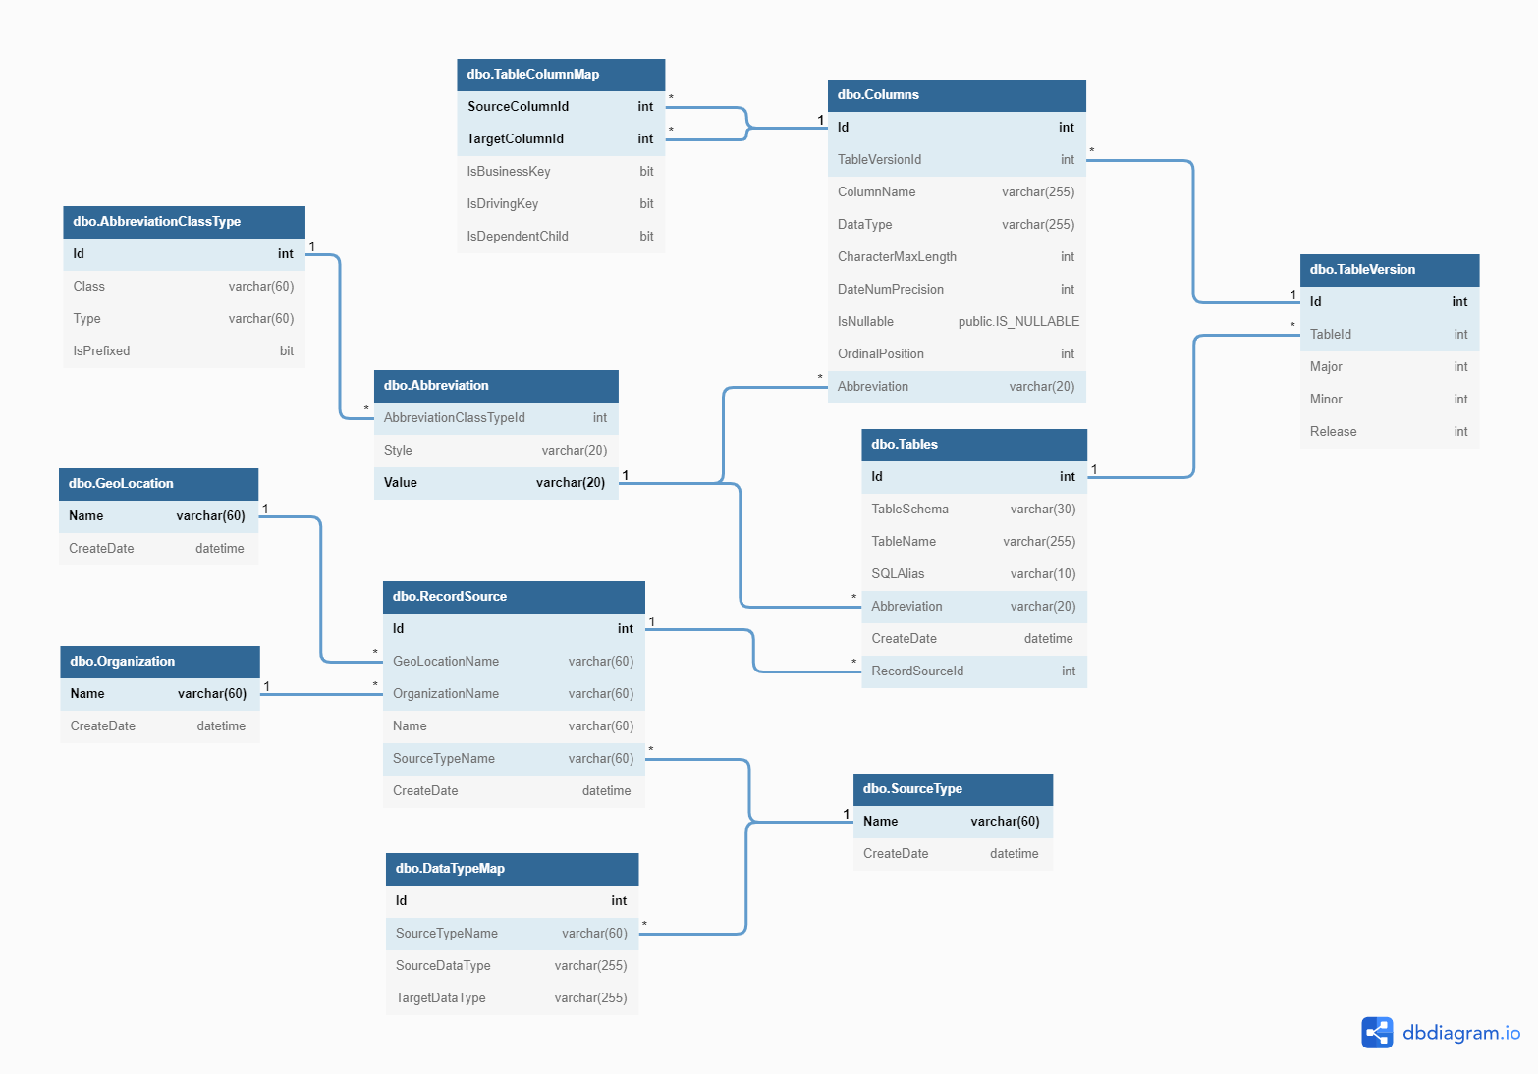
Azure DV Engine data model
Metadata Layout - dbdiagram.io

Slide 14
developing the automation pipelines

Slide 15
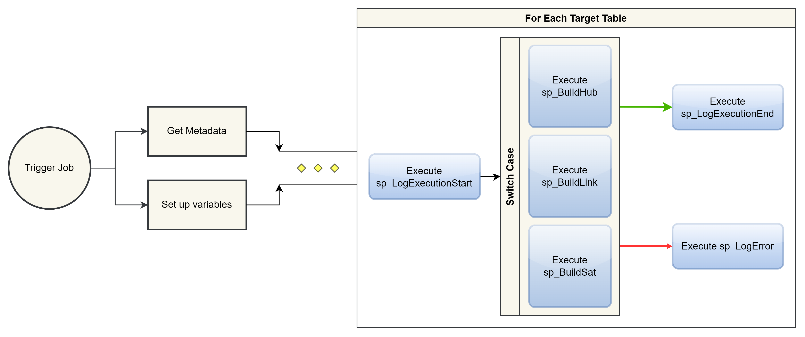
The basic pipeline flow for now

Slide 16
Resources
Deploying Data Vault on Azure SQL Data Warehouse (microsoft.com) [https://azure.microsoft.com/en-us/resources/deploying-data-vault/]
(92) Design your Data Vault and Load it with Azure Data Factory - Rayis Imayev – YouTube
My GitHub Repo for this Presentation and Project

Slide 17
THANK YOU
Noel Cruz
noel.ivan.cruz@gmail.com
www.github.com/nicruzer

